Slide 1
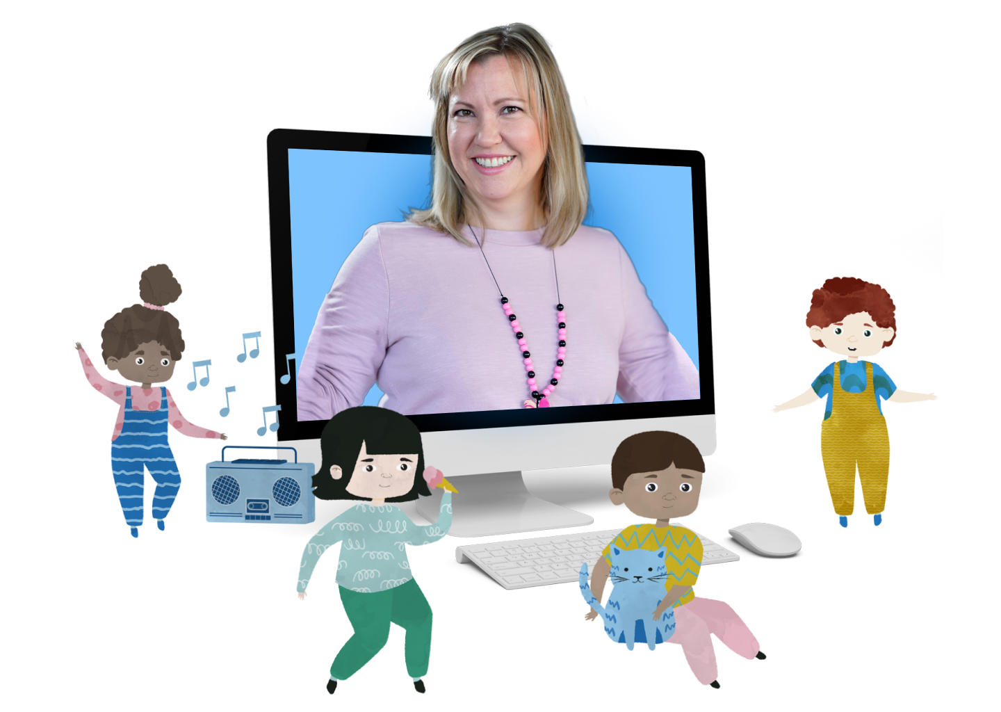
Joyful International English Clubs
How to prepare
for the first trial class
prepared by Language Clubhouse
becky@language-clubhouse.com
clubs.language-clubhouse.com

Slide 2
Content
How to Prepare Your Child for the Class
How to join the trial lesson
What you need before the lesson
What to expect during the trial lesson
What happens after the trial lesson
Contact us

Slide 3
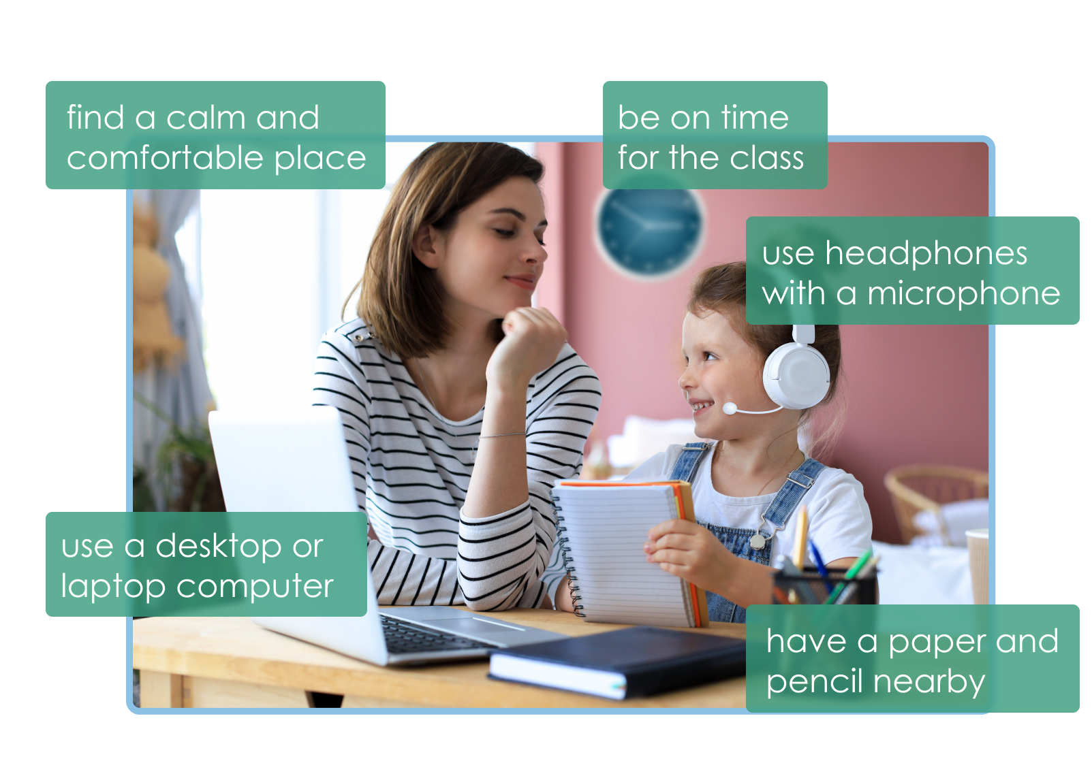
How to prepare your Child for the Class
● Explain your child that the class is a pure English speaking environment, but don't worry our teachers are sensitive to the needs of the children! So even if your kid doesn’t speak English, it’s okay, just tell them, it’s a new experience and the first step on their journey to learn their second language.
● Support your child between classes; help with homework and be interested in what your child is learning at the moment. It takes a lot of practice to learn languages, so the more you practice at home the better for your child.
When in doubt, ask the teacher for help
● Always contact the teacher or becky@language-clubhouse.com or +358409114110 with any questions.
● It helps to be encouraging, not forcing your child to speak the language. By this way the child gains confidence and courage to speak.
Since we strive to have a positive learning environment for our clubs we use a Positive Behavior Interventions and Support (PBIS) approach in our school. We verbally acknowledge good behavior and give incentives like rewards to students.
We Wish You Much Success In Language Learning!

Slide 4
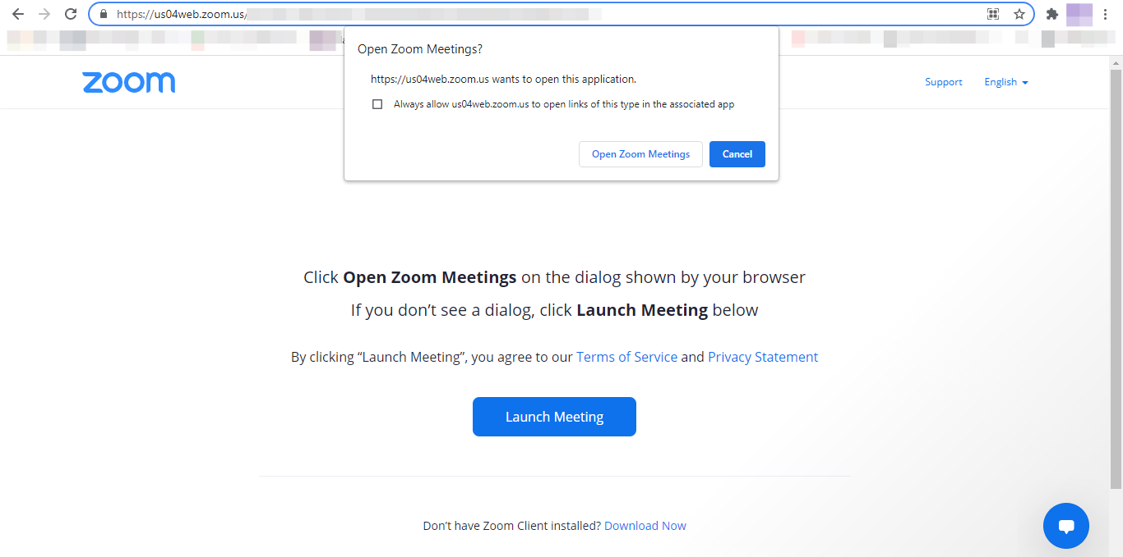
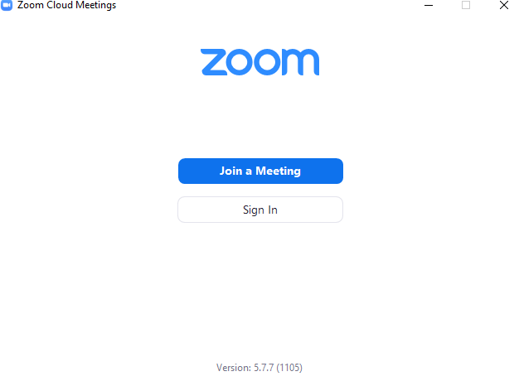
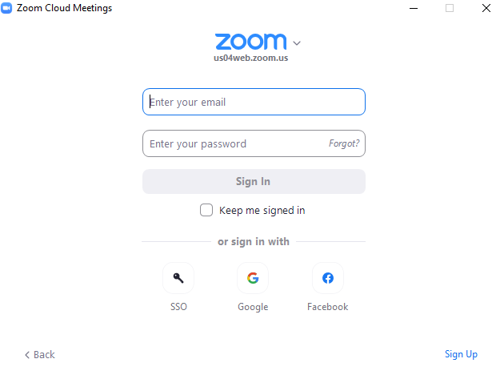
How to join
The trial lesson
All lessons will take place on Zoom
Step 1 - Follow the link we sent you via e-mail
Click “Download now” if you don’t have Zoom meetings app on your computer or tablet and follow further instructions.
If you have Zoom meetings app, then just click on “Open Zoom meetings”.
Step 2 - Sign in or
Sign up in the system

Slide 5
What you need
before the lesson
You are almost there!
Step 3 - Check if you have:
a working microphone;
working speakers or headphones;
a working camera on the computer or tablet.
Step 4 - Now follow the link that we sent you via e-mail again, you should be able to join the meeting immediately.
*Once you setup the app, all you need to do to join the next classes is to follow the class link.
If you get lost on the way, please, feel free to contact me via WhatsApp +358 40 9114110!

Slide 6
What to expect
during the trial lesson
A typical English Lesson Structure: Trial classes are 30 min long, regular classes last for 45-60 min
1
Welcome and greetings
Physical exercises and activities/games
New vocabulary introduction
Social activity: song, rhyme, game or story
Individual activity: writing, reading, or craft time
Goodbyes: song or game
2
3
4
5
6
Language Clubhouse program for young learners received
High Pedagogical Quality grade from Education Alliance Finland.
Our students learn English while playing without cramming.
A glance into our online classes

Slide 7
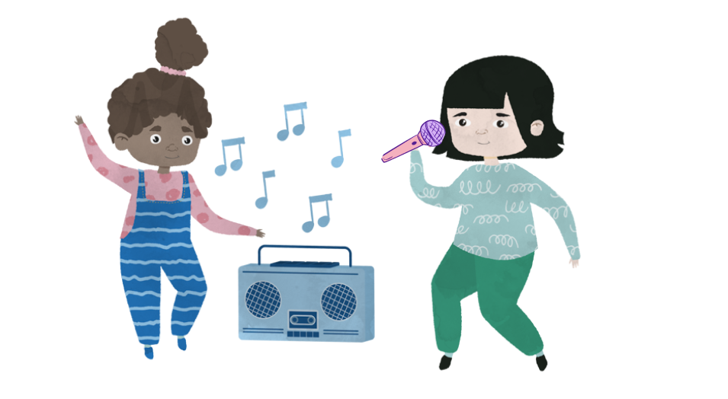
What next
after the trial lesson
After the trial lesson you will receive:
Our evaluation of your kid’s current language level and our suggestions on improvements, and placement in the right group according to level.
Link for course registration and payment
Schedule below:
Online live | English language clubs for kids | 5 week courses Starting in January 2022
LEVEL | Teacher | Topic course | Wednesdays | Thursdays | Fridays | Saturdays
A0 level | Becky | Me & My life | 17:00-17:45
A0 level | Becky | Animals | 18:00-18:45
A1 level | Nicole | Me & My life |  | 16:00-16:45
A1 level | Nicole | Seasons |  |  | 17:00-17:45
A2 level | Nicole | Animals |  |  | 18:00-18:45
A2 level | Rezvan | Seasons |  |  |  | 10:00-10:45
A2 level | Rezvan | Food |  |  |  | 11:00-11:45
Language Clubhouse is all about boosting confidence in speaking and communicating in English!
While attending our online or offline classes kids learn English in a friendly environment! We never have more than 6 kids in one online group, and more than 8 face to face. The course was designed in Finland, but it received recognition all around the globe!

Slide 8
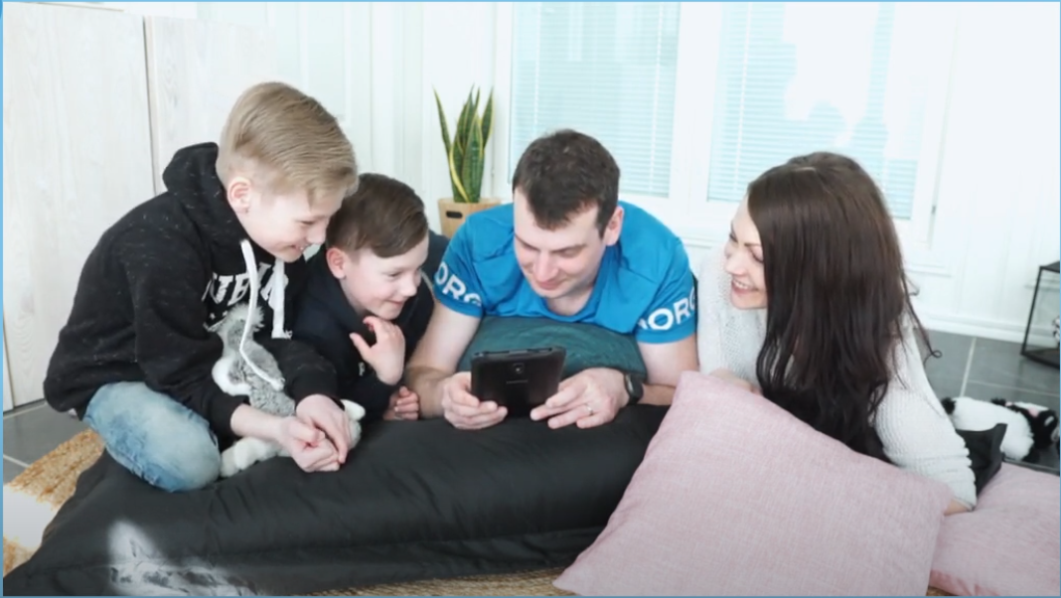
Contact us
WE ARE HAPPY TO ANSWER YOUR QUESTIONS
+358 40 911 4110
﻿becky@language-clubhouse.com

